Slide 1

Priory Woods School
Communication

Slide 2
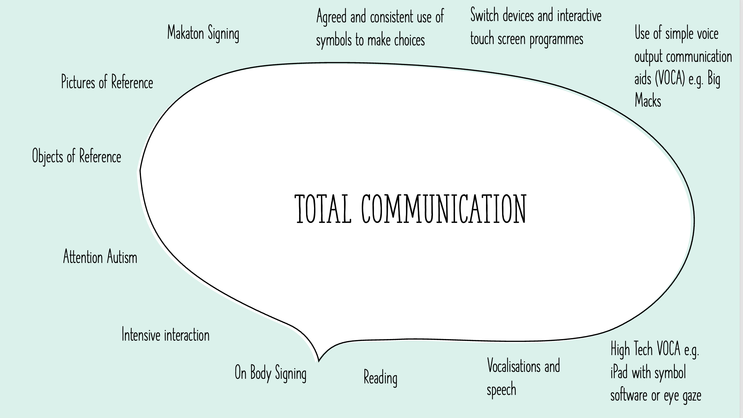
Communication at Priory Woods School includes pre-intentional communication (interpreting behaviour) and intentional communication using gestures, body language, Alternative and Augmentative Communication (AAC) and speech. Each pupil has personalised systems and strategies that are matched to their needs and abilities.
Examples of strategies that we may use to support a pupil include –

Slide 3
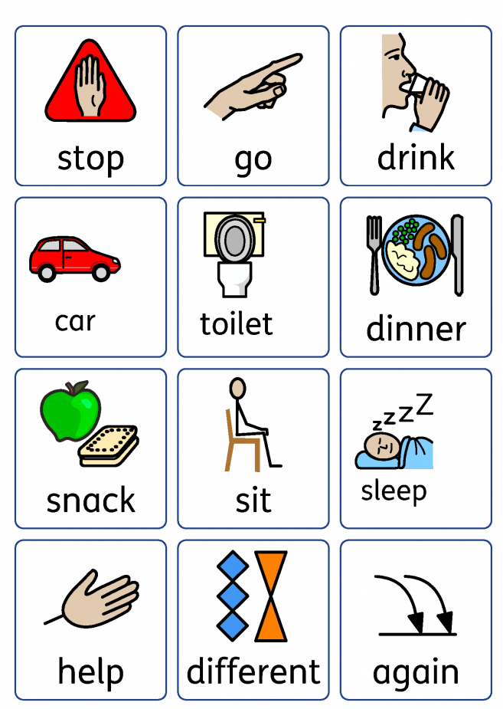
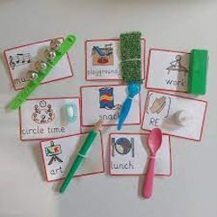
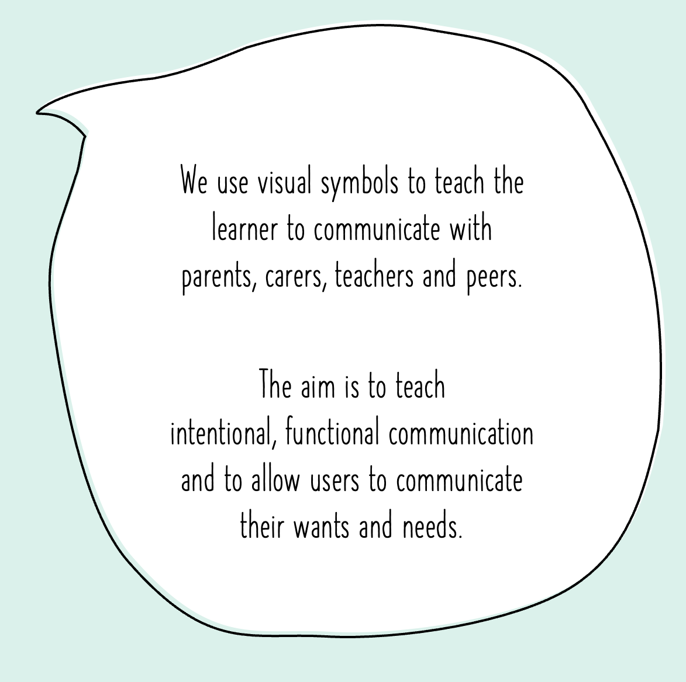
Objects of Reference
An object of reference is a whole physical object, or part of an object, that you hold or touch to represent or identify:
A person.
An object.
A place.
An activity.
An idea.

Slide 4
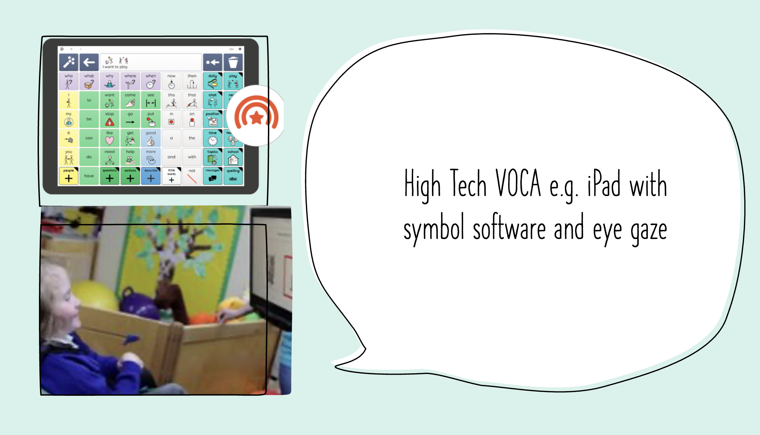
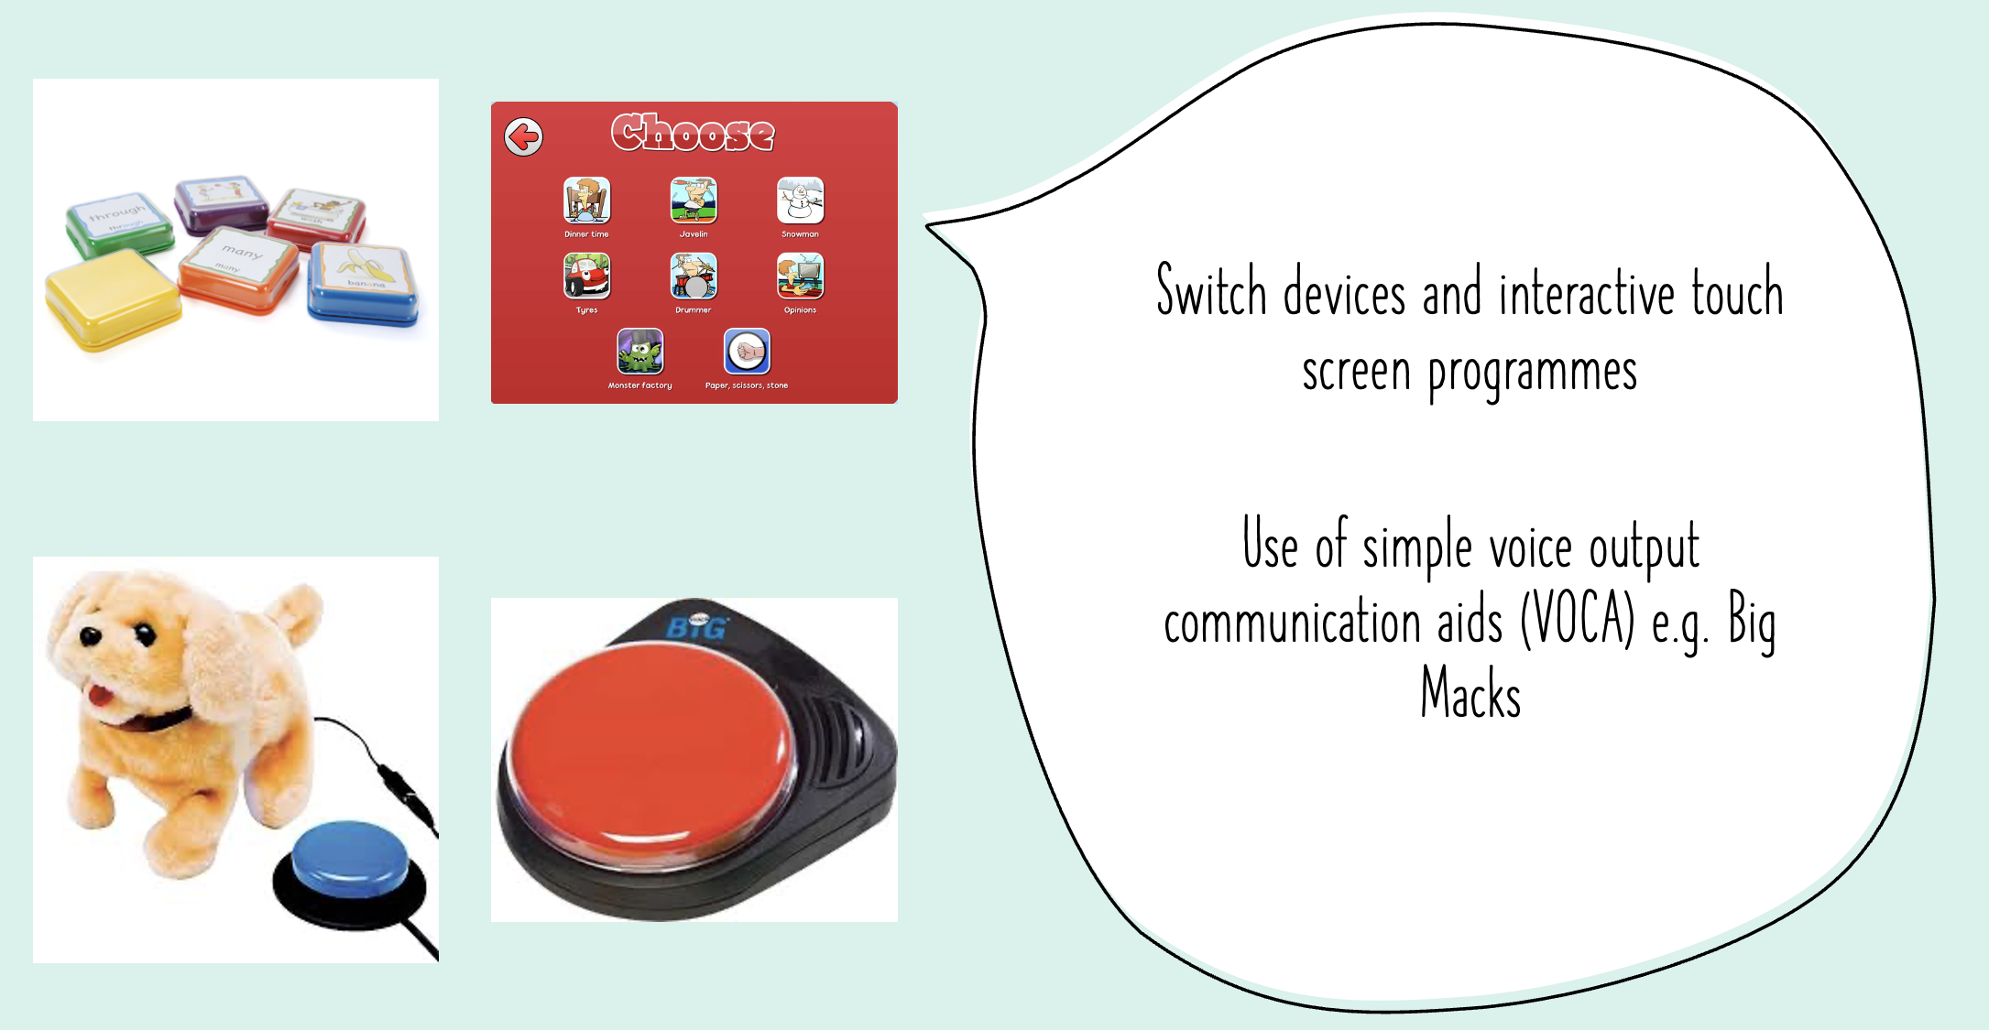

Slide 5
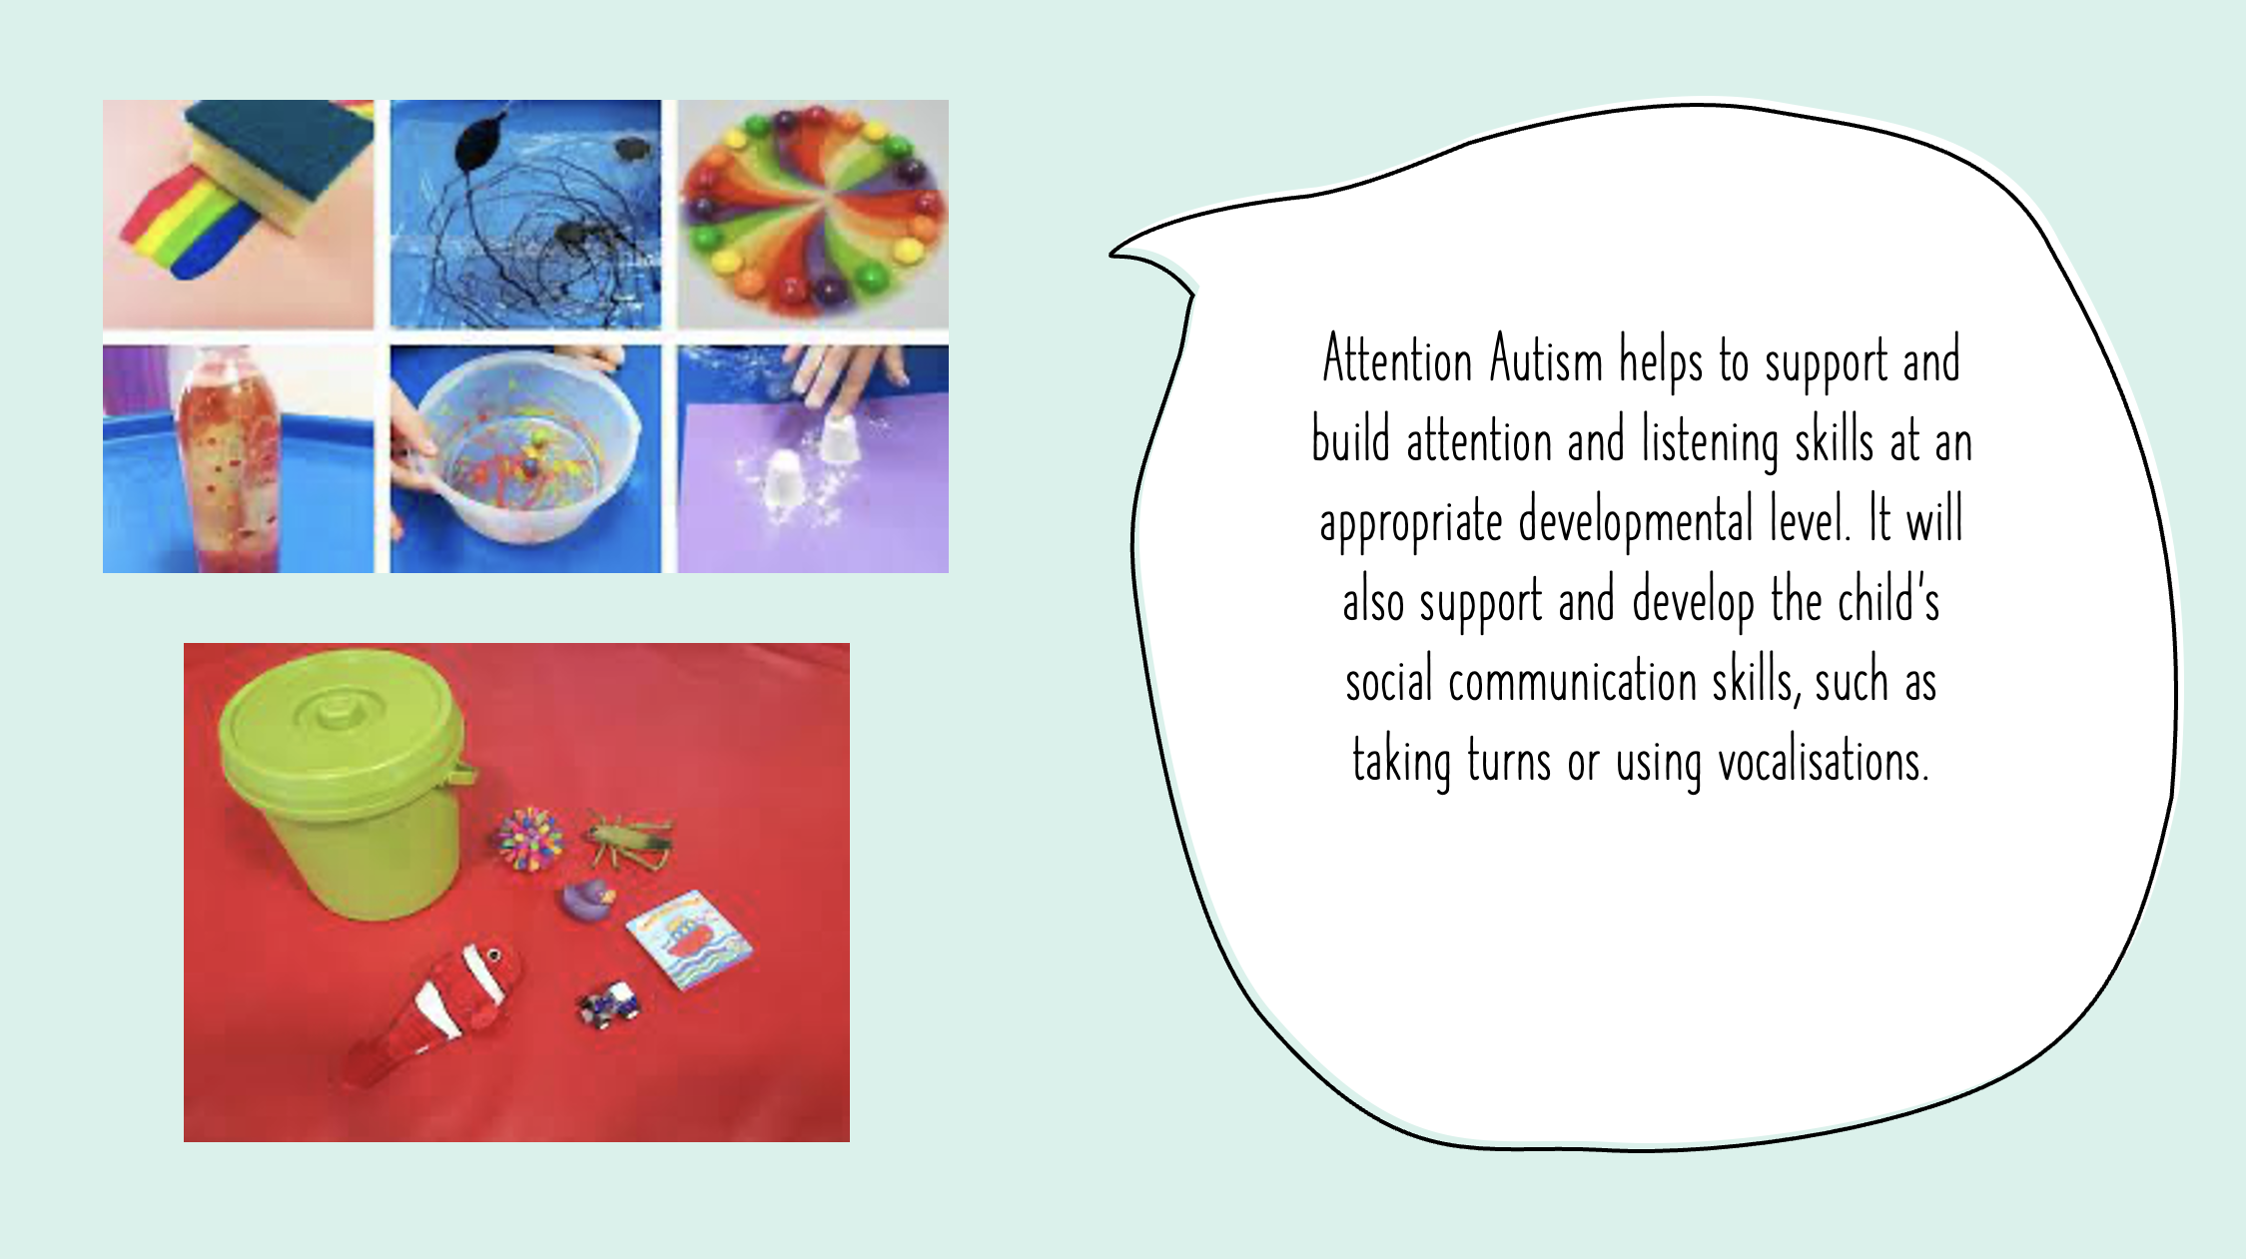
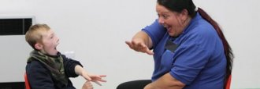
with learning disabilities who do not
Intensive Interaction
Intensive Interaction is a practical approach to interacting with people with learning disabilities who do not find it easy communicating or being Intensive Interaction
Intensive Interaction is a practical approach to interacting with people

Slide 6
Outcomes are reported on individually within each pupils learning intentions, through MAPP, and next steps are based on their progress and achievements as well as their SaLT assessments.

